Slide 1
NEUROTRANSMITTERS -
Biogenic amines
Katarzyna Kuśmierska,

Slide 2
The disorders of biogenic amines metabolism
can be divided into 2 categories :
1. affecting the enzymes of monoamines biosynthesis
and catabolism
2. affecting the enzymes of tetrahydrobiopterin
synthesis and recycling
GTP
Neopteryn
TYROSINE (TH)
TRYPTOPHAN (TPH)
BH₄
TYROSINE
HYDROXYLASE
TRYPTOPHAN
HYDROXYLASE
BH₂
OMD
L-Dopa
5-OH-TRYPTOPHAN
AROMATIC L-AMINO ACID DECARBOXYLASE (AADC)
PNP
NOREPINEPHRINE
DOPAMINE
SEROTONINE
DOPAMINE
Β-HYDROXYLASE
monoamine oxidase (MAO)
Catechol-O-methyltransferase
HVA
5-HIAA

Slide 3
CATECHOLAMINES AND SEROTONIN ARE RELATED TO
CENTRAL AND AUTONOMOUS VEGETATIVE NERVOUS SYSTEM FUNCTION HAVING A DIVERSE RANGE OF ACTION.
CATECHOLAMINES (dopamine, norepinephrine and epinephrine):
In the central nervous system they provide control of psychomotor function, being involved in the regulation of motor coordination and processing of sensory input.
Peripherally - involve the regulation of vascular tone and blood flow.
SEROTONIN:
Centrally, serotonin provides control of emotional stability, memory, appetite, mood, sleep.
Peripherally, the controle of thermoregulation.

Slide 4
CLINICAL SYMTOMS:
EARLY SIGNS
movement disorder with early onset truncal hypotonia; peripheral hypotonia/hypertonia, eye movement abnormalities
EXTRAPYRAMIDAL SYMPTOMS
parkinsonian signs (rigidity, tremor, bradykinesia, masked facies),
dystonia (Segawa dopa-responsive dystonia – diurnal fluctuation);
PERIODIC EPISODES
oculogyric crises, paroxysmal movements, paroxysmal general hypertonia

Slide 5
PSYCHIATRIC/BEHAVIORAL SYMPTOMS
irritability, depression, mental retardation
SLEEP DISTURBANCE
hypersomnolence, difficulty maintaining sleep
AUTONOMIC SYMPTOMS
temperature instability, gastrointestinal symptoms , excessive drooling,
DIURNAL FLUCTUATIONS

Slide 6
THE CLINICAL DIAGNOSIS OF INHERITED NEUROTRANSMITTERS DISORDERS IS VERY DIFFICULT
AND NEEDS BIOCHEMICAL FINDINGS LIKE A BIOGENIC AMINE METABOLITES
The investigation of biogenic amines metabolism is complicated
because
biochemical findings in peripheral fluids are generally uninformative
Analysis of biogenic amines metabolism requires
LUMBAR PUNCTURE

Slide 7
THE MAJOR METABOLITES OF BIOGENIC AMINES THAT APPEAR IN CSF:
- homovanillic acid (HVA) for dopamine metabolism,
- 5-hydroxyindoloacetic acid (5-HIAA) for serotonin metabolism,
- 3-O-methyldopa (3-OMD) as diagnostic metabolite of l-dopa.
- Methyl-OH-phenylglicol (MHPG) for norepinephrine metabolism

Slide 8
Phenylalanine BH₄
Tyrosine Tryptophan
3-OMD L-dopa BH₂ 5-HT
E NE Dopamine Serotonin
HVA 5-HIAA
PAH
TH
TPH
BDH
AADC
B₆
MAO
COMT
Disorders of biogenic amines metabolism include the deficiencies of
1. Tyrosine hydroxylase (TH)
2. Aromatic L-amino acid decarboxylase (AADC)
3. Dopamine β-hydroxylase (DBH)
4. Monoamine oxidase (MAO)
5. Catechol – O – methyltransferase (COMPT)
Tetrahydrobiopterin (BH₄) metabolism disorders

Slide 9
BH₄ IS ESSENTIAL COFACTOR FOR
BOTH TYROSINE AND TRYPTOPHAN HYDROXYLASES,
THE RATE – LIMITING ENZYMES IN THE BIOSYNTHESIS OF
DOPAMINE and SEROTONIN

Slide 10
TETRAHYDROBIOPTERIN (BH4) DEFICIENCIE CONTAINS
A HETEROGENOUS GROUP OF DISORDERS CAUSED BY MUTATION IN ONE OF THE GENES ENCODING ENZYMES INVOLVED IN THE BIOSYNTHESIS OR REGENERATION OF BH4
THESE DISORDERS CAUSE
MONOAMINE NEUROTRANSMITTER DEFICIENCY

Slide 11
GTP
GTPCH
Dihydroneopterin triphosphate Neopterin
PTPS
6-pyruvoyl-tetrahydropterin
AR/CR SR/CR
Sepiapterin 1-Oxo-PH₄ 2-Oxo-PH₄
SR/CR SR AR
7,8-Dihydrobiopterin ^{DHFR} Tetrahydrobiopterin (BH₄) DHPR
q-Dihydrobiopterin
Biopterin
Disorders of BH₄ metabolism include the deficiencies of
GTP Cyclohydrolase I (GTPCH I)
6-Pyruvoyl-tetrahydropterin synthase (PTPS)
Sepiapterin reductase (SR)
Dihydropterin reductase (DHPR)

Slide 12
The enzymes deficiency lead to abnormal pattern of metabolites of monoamines and pterins

Slide 13
GTP
GTPCH
Dihydroneopterin triphosphate Neopterin
PTPS
6-pyruvoyl-tetrahydropterin
AR/CR SR/CR
Sepiapterin 1-Oxo-PH₄ 2-Oxo-PH₄
SR/CR SR AR
7,8-Dihydrobiopterin ^{DHFR} Tetrahydrobiopterin (BH₄) DHPR
q-Dihydrobiopterin
Biopterin
GUANOSINE TRIPHOSPHATE (GTP) CYCLOHYDROLASE I DEFICIENCY (GTPCH I)
The enzyme GTPCH I catalyzes conversion of GTP to dihydroneopterin triphosphate, the first step in the biosynthesis of BH₄

Slide 14
GTPCH deficiency occurs in autosomal recessive (AR)
and
autosomal dominant (AD) forms
AR form presents with complex neurological disfunction, icluding global developmental delay, spasticity and seizures
AD form presents as Dopa-responsive dystonia (DRD)

Slide 15
Patients with AR form are usually recognized because of HPA
(elevated Phe cocentration in blood is typically evident on routine newborn screening)
HPA has never been reported in any patient with dominantly inherited GTPCH deficiency

Slide 16
BH4 deficiency without HPA
CYKLOHYDROLASE GTP - GTP-CH I (AD!!!)
REDUCTASE SEPIAPTERIN– SR
DYSTONIA (LOWER LIMBS, torso, UPPERS LIMBS, NECK)
PARKINSONISM (tremor, muscle stiffness, bradykinesia, limitation of movements, hypommia)
Oculogyric crisis(ONLY SR)
COGNITIVE DELAY (ONLY SR)

Slide 17
GTP CH I (AD)
SEGAWA DYSTONIA
L-DOPA RESPONSIVE DYSTONIA

Slide 18
GTP CH 1 DEFICIENCY
AD – MUTATION IN ONE ALLELE
AR – COMPOUND HETEROZYGOTE/HOMOZYGOTE
SYMPTOMS MOST COMMON 4-10 years of age
THEY MAY APPEAR FROM 1 TO 80 YEARS OF AGE.
USUALLY LOWER LIMB DYSTONIA
GOOD RESPONSE TO L-DOPA
HYPERPHENYLALANINEMIA + SYMPTOMS FROM 1 MONTHS
REQUIRES COMPLEX TREATMENT BH4, L-DOPA, 5-HTP,

Slide 19
E.M. ur. 1983 (23 lata)
SEAT 6/12
standing by the furniture 10/12
walking near furniture 14/12 and begins to walk independently (walks unsteadily)
rehabilitation from 2 y – without good results
At the age 3rd she started walking on tiptoe

Slide 20
E.M. ur. 1983 (23 lata)
4 yrs – Achilles tendon lengthening surgery
4-5 yrs . she doesn't walk, she starts sitting unsteadily;
in a psychological examination at the age of 5 - normal

Slide 21
E.M. ur. 1983 (23 lata)
9 – 10 yrs poor head stabilization, cannot sit independently
problems with fine motor skills
micturition disorders (urinary incontinence)

Slide 22
E.M. ur. 1983 (23 lata)
11 – 12 years the best student in the class, she writes on the computer, she cannot stabilize her head
18 years – very painful periodic tension, muscle stiffness
19 years – speech disorders, swallowing disorders, excessive salivation

Slide 23
E.M. ur. 1983 (23 lata)
20 years – intestinal peristalsis disorders, constipation, difficulties in eating, increasing cachexia
DIURNAL FLUCTUATION

Slide 24
E.M. ur. 1983 (23 lata)
MRI BRAIN – normal
AMINO ACIDS, ORGANIC ACIDS, LACTATE - normal
EMG - normal

Slide 25
E.M. ur. 1983 (23 lata)
21 yrs – First visit
cachexia, permanent contractures in the feet,
swallowing disorders, salivation
dysarthric speech, temporary breathing difficulties

Slide 26
E.M. ur. 1983 (23 lata)
muscle stiffness, cogwheel, tremors, muscle jerks
lack of deep reflexes
EXTRAPYRAMIDAL SYNDROM

Slide 27
Biochemical findings for the patient with GTPCH deficiency (AD)
 | Before treatment (17 y) | Reference range
BA metabolites HVA [nmol/L] (CSF) 5-HIAA [nmol/L](CSF) 3-OMD [nmol/L] (CSF) | 32 12 nd | 100 – 600 50 – 400 < 50
Pterins ^{(*)} Bio [nmol/L] (CSF) Neo [nmol/L] (CSF) BH₂ [nmol/L] (CSF) Sepiapterin | 3,2 0,5 not analysis not analysis | 11 – 41 4,1 – 35
Prolactine | 14 | 2,7 – 19,7
Phenylalanine loading test | ABNORMAL
Response to l-dopa treatment | Excellent

Slide 28
Summary
GTPCH deficiency presents with:
- abnormal concentration of biogenic amine metabolites in CSF
- abnormal profil of pterin in CSF
(very low concentration of neopterin and biopterin)
- abnormal phenylalanine loading test
GTPCH deficiency occurs in two forms: autosomal recessive and autosomal dominate
GTPCH deficiency presents with HPA (AR) and without HPA (AD)

Slide 29
Inherited PTPS deficiency is a heterogeneous disease
with different phenotypes
leading to BH4 depletion.
The severe form of PTPS deficiency
causes HPA and monoamine neurotransmitter deficiency, whereas the mild form gives rise to HPA only.

Slide 30
Biochemical findings for the patient with PTPS deficiency
 | Before treatment (1 m) | Reference range
BA metabolites HVA [nmol/L] (CSF) 5-HIAA [nmol/L](CSF) 3-OMD [nmol/L] (CSF) | 21 4 nd | 100 – 600 50 – 400 < 50
Pterins ^{(*)} Bio [nmol/L] (CSF) Neo [nmol/L] (CSF) BH₂ [nmol/L] (CSF) Sepiapterin | 14,7 87 not analysis not analysis | 11 – 41 4,1 – 35
Prolactine | n.a. | 2,7 – 19,7
Phenylalanine loading test | n.a.
Response to l-dopa treatment | good
n.a. – not analysed

Slide 31
Girl was born 2010
Families history –
PARENTS, YOUNG, HEALTHY, UNRELATED
CIII PIII SN. 9/10 p.Apgar
INCREASED CONCENTRATION OF PHENYLALANINE IN THE NBS

Slide 32
SUMMARY
PTPS deficiency presents with:
- elevated phenylalanine concentration in plasma,
- abnormal biogenic amine metabolites in CSF
- abnormal pterin profile in CSF and urine
SIGNIFICANT INCREASE OF NEOPTERIN IN CSF
- reducing the activity of this enzyme

Slide 33
DIHYDROPTERINE REDUCTASE - KEY ROLE IN BH4 SYNTHESIS

Slide 34
DHPR DEFICIENCY IS, IN GENERAL, A SEVERE DISORDER
LEADING TO HPA
AND LOW LEVELS OF HVA AND 5-HIAA IN CSF.
ELEVATED LEVELS OF TOTAL BIOPTERIN IN CSF AND URINE IS OBSERVED
A SECONDARY DEFICIT OF 5-METHYLTETRAHYDROFOLATE (MTHF)
CAN OCCUR IN DHPR DEFICIENCY

Slide 35
Biochemical findings for the patient with DHPR deficiency
 | Before treatment (20 y) | Reference range
BA metabolites HVA [nmol/L] (CSF) 5-HIAA [nmol/L](CSF) 3-OMD [nmol/L] (CSF) | nd nd nd | 200 – 800 100 – 600 < 50
Pterins ^{(*)} Bio [nmol/L] (CSF) Neo [nmol/L] (CSF) BH₂ [nmol/L] (CSF) Sepiapterin | 45 18 90 n.a. | 10 – 42 4,1 – 35 0,4 – 14 nd
Phenylalanine [umol/L] | 120 | 42 - 89
Phenylalanine loading test | n.a.
5-MTHF | 20 | 48 - 180
nd – not detected
n.a. – not analyzed

Slide 36
SUMMARY
DHPR deficiency presents with:
- elevated phenylalanine concentration in plasma and CSF
- abnormal concentration of biogenic amine metabolites in CSF
- abnormal pterin profile in CSF and urine
( hight concentration of BH₂ in CSF)
- decreased 5-MTHF in CSF
- decreased enzyme activity in whole blood

Slide 37
GTP
GTPCH
Dihydroneopterin triphosphate Neopterin
PTPS
6-pyruvoyl-tetrahydropterin
AR/CR SR/CR
Sepiapterin 1-Oxo-PH₄ 2-Oxo-PH₄
SR/CR SR AR
7,8-Dihydrobiopterin ^{DHFR} Tetrahydrobiopterin (BH₄) DHPR
q-Dihydrobiopterin
Biopterin
SEPIAPTERIN REDUCTASE DEFICIENCY (SRD)
SR catalyzes the last step in the tetrahydrobipterin (BH₄) biosynthesis, converting 6-pyruvoyl-tetrahydropterin to BH₄ in an NADPH dependent reaction.

Slide 38
Dopa-responsive dystonia
Diurnal fluctuation
Oculogyric crisis (NAPADY WEJRZENIOWE)
BEHAVIORAL DISORDERS :
LACK OF SELF-REGULATION (sudden CRYING)
SLEEP DISORDERS (EXCESSIVE Drowsiness, DIFFICULTY IN SLEEPING)
IMPROVEMENT AFTER SLEEP

Slide 39
Sepiapterin reductase deficiency (SRD) is an autosomal recessive disorder
with normal phenylalanine (Phe) concentration
in blood.

Slide 40
Sepiapterin
Tyr Trp L-Arg + O₂
TH TPH NOS BH₄
L-Dopa 5-OH-Trp L-Cit + NO.
H₂O₂ 0₂.
Neurotoxicity 0N00.
BH₂
-
-
Influence of BH2 on TH, TPH and NOS

Slide 41
Girl was born 2005
PREGNANCY AND BIRTH AND THE NEWBORN PERIOD - normal
AT THE AGE OF 3 MONTHS PROLONGED EPISODES IMPROPER EYEBALL SETTINGS
HORIZONTAL OR UP WITH A CRYING, OCCURRING MANY TIMES A DAY and
THEY DISAPPEARED AFTER SLEEP
SYMPTOMS EXHIBITED DAILY CHANGES, INCREASING AT THE END OF THE DAY.

Slide 42
CASE REPORT
At 7 and 10 months of age intensive etiologic investigations were normal.
- plasma acylcarnitines, free carnitine,
- lactate and pyruvate,
- urinary organic acids,
- muscle biopsy,
- electroencephalograms,
- cerebral magnetic resonance imaging

Slide 43
Biochemical findings for the patient with SRD
 | Before treatment (7 months) | 11 months treated with l-dopa | 15 months treated with L-dopa and 5-HT | Reference range
BA metabolites HVA [nmol/L] (CSF) 5-HIAA [nmol/L](CSF) 3-OMD [nmol/L] (CSF) | 79,7 12,3 nd | 119 12,5 46 | 82 < 5 54 | 200 – 800 100 – 600 < 50
Pterins ^{(*)} Bio [nmol/L] (CSF) Neo [nmol/L] (CSF) BH₂ [nmol/L] (CSF) Sepiapterin | 24 18 69 14,7 | - - - | - - - | 10 – 42 4,1 – 35 0,4 – 14 nd
Prolactine | 15,3 |  | - | 2,7 – 19,7
Phenylalanine loading test | Abnormal
Molecular study of SPR gen (**) | g.1330C>G (p.N127K)
*Metabolic Unit, Dept. Clinical Chemistry, prof. C. Jakobs
**Division of Clinical Chemistry and Biochemistry, prof. N.Blau

Slide 44
Girl was born 2005
PSYCHOMOTORY DEVELOPMENT IS NORMAL UNTIL 4 MONTH,
AXIAL HYPOTONIA, LACK OF HEAD STABILIZATION
At the age 1:
SHE DIDN'T SIT DOWN, no HEAD STABILIZATION
Axial hypotonia, stiff limbs was observed
live tendom reflexe

Slide 45
girl ur. 30.03.2005
MRI brain - normal
EEG normal

Slide 46
gradual introduction of treatment,
in small doses!!!!!
LEVODOPA + BENSERAZYD 7 mg/kg/day
NEXT L-DOPA + CARBIDOPA
NEXT 5-HYDROXYTRYPTOPHANU 1,5 mg/kg/day
SIT AFTER 2 MONTHS of treatment

Slide 47
SUMMARY
Sepiapterin reductase deficiency presents with:
- normal phenylalanine concentration in plasma
- abnormal concentration of biogenic amine metabolites in CSF
- abnormal pterin profile in CSF
(very hight concentration of sepiapterin in CSF)
- abnormal phenylalanine loading test
- normal/abnormal prolactine concentration in serum

Slide 48
TYROSINE HYDROXYLASE DEFICIENCY (THD)
Phenylalanine BH₄
Tyrosine Tryptophan
3-OMD. L-dopa BH₂ 5-HT
E NE Dopamine Serotonin
HVA 5-HIAA
PAH
TH
TPH
BDH
AADC
B₆
MAO
COMT
Tyrosine hydroxylase (TH, EC 1.14.16.2) catalyzes the hydroxylation of L-tyrosine to L-dopa, the rate limiting step in the biosynthesis of the dopamine, norepinephrine, and epinephrine.
Reaction requires molecular oxygen, ferrous iron and the cofactor BH₄ for activity.

Slide 49
TYROSINE HYDROXYLASE DEFICIENCY (THD)
This disorder is known under different names in the literature, namely ‘Segawa syndrome’, ‘infantile parkinsonism’ and ‘L-dopa-responsive dystonia’ (DRD).
‘Segawa syndrome’, however, is also used to indicate another defect in neurotransmitter biosynthesis, caused by GTP cyclohydrolase I mutations.
‘Infantile parkinsonism’ and DRD are not found in all patients with THD.
The phenotype of THD can be so different that it is not simply associated only with an extrapyramidal movement disorder.

Slide 50
BIOCHEMICAL FINDINGS IN TH DEFICIENCY:
biogenic amine metabolites in CSF
pterin profile in CSF
phenylalanine loading test
molecular study

Slide 51
TH deficiency
WIDE PHENOTYPE SPECTRUM
Based on the severity of symptoms and response to levodopa treatment,
DOPA-RESPONSIVE DYSTONIA (MILD TH DEFICIENCY)
INFANTILE PARKINSONISM WITH MOTOR DELAY (SEVERE FORM)
(3) PROGRESSIVE PEDIATRIC ENCEPHALOPATHY (VERY SEVERE FORM)

Slide 52
DOPA-RESPONSIVE DYSTONIA (MILD TH DEFICIENCY)
(DYT5B, DYT-TH)
onset of symptoms 12 months and 12 years;
THE INITIAL SYMPTOMS ARE USUALLY LOWER LIMB DYSTONIA
AND/OR DIFFICULTY IN WALKING
DIURNAL FLUCTUATION
(SYMPTOMS WORSE IN THE EVENING AND IMPROVEMENT AFTER SLEEP).

Slide 53
INFANTILE PARKINSONISM WITH MOTOR DELAY
(SEVERE FORM)
THE BEGINNING OF THE DISEASE IT OCCURS FROM 3 TO 12 MONTHS
INFANT SHOW AXIAL HYPOTONIA
AND PARKINSON'S SYMPTOMS
(HYPOKINESIA, STIFFNESS OF LIMBS AND/OR TREMOR)

Slide 54
PROGRESSIVE PEDIATRIC ENCEPHALOPATHY (VERY SEVERE FORM)
THE ONENSE OF THE DISEASE OCCURS AT THE AGE OF THREE TO SIX MONTHS
IN MOST CASES, ABNORMALITIES DURING THE FETAL PERIOD
SIGNIFICANT DELAY IN MOTOR DEVELOPMENT,
AXIAL HYPOTONIA, SEVERE HYPOKINESIS,
LIMB HYPERTONIA (STIGNESS AND/OR SPASTICITY), EYELID DROPPING (PTOSIS)
INTELLECTUAL DISABILITY
PERIODS OF EXCESSIVE SLEEPY (WITH INCREASED SWEATING AND DIVILING)

Slide 55
EEG normal.
MRI - normal.
Age-appropriate myelination.
The ventricular system is of normal width, symmetrical.
Paracerebral fluid spaces not dilated.
Tandem MS-MS(MS/MS) - NORMAL
ORGANIC ACIDS PROFILE GC-MS - NORMAL

Slide 56
?
LUMBAR PUNCTION– NEUROTRANSMITTER ANALYSIS

Slide 57
BIOCHEMICAL RESULTS FOR THE PATIENT WITH THD
 | Before treatment (7m) | Reference range
BA metabolites HVA [nmol/L] (CSF) 5-HIAA [nmol/L](CSF) 3-OMD [nmol/L] (CSF) | 50 199 nd | 300 – 1000 200 – 800 < 100
Pterins ^{(*)} Bio [nmol/L] (CSF) Neo [nmol/L] (CSF) | 41 15,5 | 10 – 42 4,1 – 35
Prolactine | 12,6 | 2,7 – 19,7
Phenylalanine loading test | Normal
Molecular study of TH gen | During the study
Excellent respons to low dose of L-dopa

Slide 58
Summary
THD DEFICIENCY PRESENTS WITH:
- abnormal concentration of biogenic amine metabolites in CSF
(very low concentration of HVA in CSF)
- normal pterin profile,
- normal phenylalanine loading test,
Only molecular study can be confirmation for the TH deficiency

Slide 59
L-AROMATIC AMINO ACID DECARBOXYLASE DEFICIENCY
Phenylalanine BH₄
Tyrosine Tryptophan
3-OMD L-dopa BH₂ 5-HT
E NE Dopamine Serotonin
HVA 5-HIAA
PAH
TH
TPH
BDH
AADC
B₆
MAO
COMT
Aromatic L-amino acid decarboxylase (AADC, EC 4.1.1.28) catalyzes the conversion of 5-hydroxytryptophan to serotonin in serotonergic neurons and of L- dopa to dopamine in catecholaminergic neurons and adrenal medullary cells.
This enzyme thus plays a key role in the synthesis of both groups of neurotransmitter biogenic amines.

Slide 60
Biochemical findings in AADC deficiency:
Organic acids profile in urine
Prolactine in serum
Biogenic amine metabolites in CSF
5-MTHF IN CSF
Enzyme activity
Molecular analysis

Slide 61
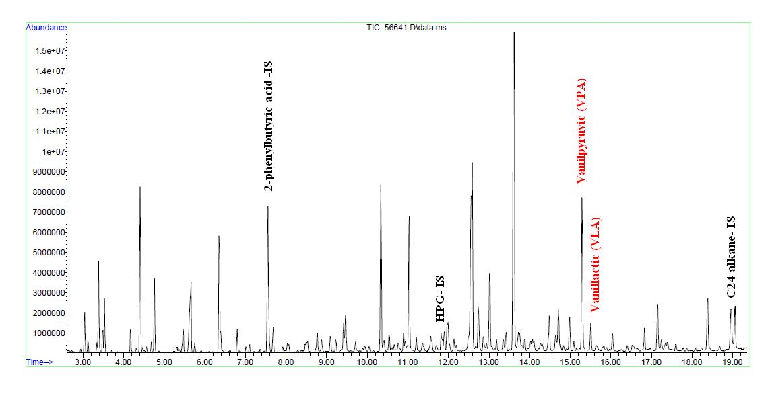
Organic acid profile in urine – patient with AADC deficiency

Slide 62
Organic acids profile in urine - control

Slide 63
Biochemical findings for the patients with AADC deficiency
 | Patient (8 m) | Control
5-HT [nmol/L] (CSF) | 380 | < 10
HVA [nmol/L] (CSF) | 54 | 300 – 1000
5-HIAA [nmol/L] (CSF) | 46 | 200 – 800
3-OMD [nmol/L] (CSF) | 1323 | < 100
5-MTHF | 86 | 72 - 212
MHPG [nmol/L] | nd | 5 - 50
Prolactine | 32 | 2,7 – 19,7
Enzyme activity [mU/L] | nd | 16 - 99
nd: not detectable

Slide 64
SUMMARY
AADC DEFICIENCY PRESENTS WITH:
- abnormal organic acids profile in urine
to present VLA,VPA – the metabolites of 3-OMD
- abnormal concentration of biogenic amine metabolites in CSF;
- increase prolactine concentration in serum;
- decreased /normal 5-MTHF concentration in CSF;

Slide 65
AADC deficiency
Fined in 1990
130 patients around the world
Clinical symptoms
MUSCLE TENSION | MOVEMENT DISORDERS
„Flappy baby” HYPOTONIA – MAINLY AXIALSŁABA HYPERTONIA – MAINLY OF THE LIMBS | DYSKINESIS/HYPERKINESIA Chorea, athetosis DYSTONIA Oculogyric crisis HYPOKINESIS-BRADYKINESIS MIOKLONIE TREMOR
METAANALIZA Wassenberg et al. 2017

Slide 66
PSYCHOMOTOR DEVELOPMENT | BEHAVIORAL SYMPTOMS
ABNORMAL MOTOR DEVELOPMENT ABNORMAL COGNITIVE DEVELOPMENT ABNORMAL SPEECH DEVELOPMENT | IRRITABILITY AUTISTIC FEATURES DYSPHORIA / MOOD PROBLEMS CRYING
EYE SYMPTOMS | OTHER
PTOSIS SQUINT | EXCESSIVE SALIVATION EPILEPSY INSOMNIA TIREDNESS
METAANALIZA Wassenberg et al. 2017

Slide 67
Treatment
Agonist DOPAMINE | INHIBITORS MAO | OTHER
BROMOCRIPTINE PRAMIPEXOLE, ROPINIROLE, ROTIGOTINE | TRANYLCYPROMINE SELEGILINE | PYRIDOXAL PHOSPHATE (PLP) FOLIC ACID ANTICHOLINERGIC DRUGS MELATONINE
irritability, weight loss, vomiting, mild to severe dyskinesia | Side effects have been rarely reported
METAANALIZA Wassenberg et al. 2017

Slide 68
GENE THERAPY
COOPERATION with prof. KRZYSZTOFEM BANKIEWICZ
From the UNIVERSITY of CALIFORNIA IN SAN FRANCISCO
- The first time in Poland
The first time in EUROPE
THE VIRUS, HARMFUL
TO HUMANS, IS INTRODUCED INTO THE BRAIN EQUIPPED WITH THE
GENE RESPONSIBLE FOR THE PRODUCTION OF THE AADC ENZYME

Slide 69

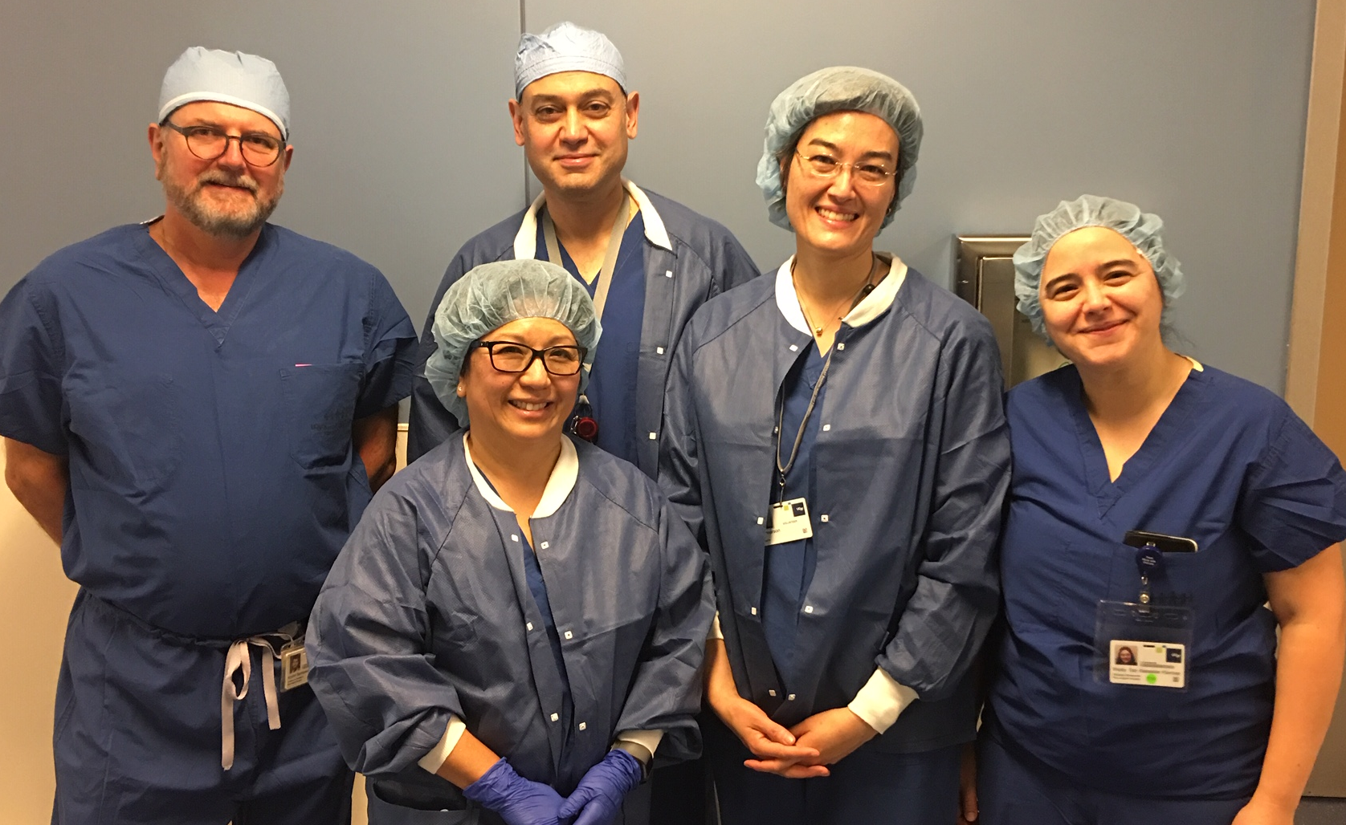


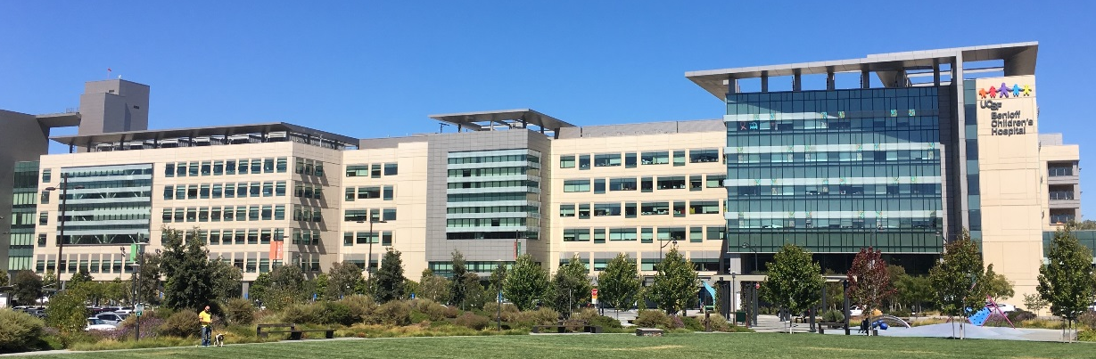
UCSF Study Team
PROF. KRYSTOF BANKIEWICZ
Krzysztof Bankiewicz (PI)
Nalin Gupta (Clinical PI)
Jill Imamura-Ching
Waldy San Sebastian
Amy Viehoever
Ana Grijalvo-Perez
Gene for AADC + VIRAL VECTOR

Slide 70
SUMMARY
AADC DEFICIENCY PRESENTS WITH:
- abnormal organic acids profile in urine
to present VLA,VPA – the metabolites of 3-OMD
- abnormal concentration of biogenic amine metabolites in CSF;
- increase prolactine concentration in serum;
- decreased /normal 5-MTHF concentration in CSF;

Slide 71
Conclusions:
Cerebrospinal fluid (CSF) analysis of biogenic amines is a screening of neurotransmitter defects and need other investigations.
Investigations of neurotransmitter defects should be included in the diagnostic evaluation of any child suffering from a progressive infantile encephalopathy of unknown etiology.

