Slide 1
Neurotransmitter disorders, BH₄
Katarzyna Kuśmierska

Slide 2
“Pediatric Neurotransmitter Diseases” is an umbrella term for genetic disorders that affect the metabolism of neurotransmitters
(synthesis and breakdown)

Slide 3
Epilepsy in IEM
Only a small percentage (< 2%?) of individuals with epilepsy have an IEM.
In 20% of cases, seizures are untreatable or very difficult control because of:
– Diffuse or localized structural brain abnormality
– Epileptic encephalopathy (Lennox‐Gastaut, etc.)
– IEM
Seizures are a very common symptom in IEM:
– Major manifestation or
– One among many other problems.
– Not always refractory to AED

Slide 4
Neonatal Metabolic Epileptic Encephalopathy
Urea Cycle Disorders
Methylmalonic, Propionic Acidurias, etc.
Marple Syrup Urine Disease
Non‐ketotic Hyperglycinemia
Pyridoxine‐dependant Epilepsy
Biotinidase Deficiency
Perinatal Hypophosphatasia
Adenylsuccinate Lyase Deficiency
MTHFR Deficiency
D‐/D‐,L‐2‐Hydroxyglutaric Aciduria
Congenital Disorders of Glycosylation
3‐Phosphoglycerate Dehydrogenase Deficiency
GABA‐T Deficiency
Congenital Glutamine Deficiency
Glutamate Transporter Deficiency
(Creatine Deficiency Disorders)
Blue indicates disorders, for which specific treatments exists.
G.F. Hoffmann: Inherited metabolic disorders presenting as epileptic encephalopathy

Slide 5
Infantile Metabolic Encephalopathy
GLUT1 Deficiency
✓ Urea Cycle Disorders
✓ Methylmalonic, Propionic Acidurias, etc.
✓ Marple Syrup Urine Disease
✓ Non‐ketotic Hyperglycinemia
✓ Pyridoxine‐dependant Epilepsy
✓ Biotinidase Deficiency
✓ Menke disease
✓ (Canavan disease)
✓ Sulphite Oxidase/ Molybdenum Cofactor Deficiency
✓ Generalized Peroxisomal Disorders
✓ Mitochondriopathies (especially MERRF)
✓ Congenital Disorders of Glycosylation
✓ Smith‐Lemli‐Opitz syndrome
✓ Adenylsuccinate Lyase Deficiency
✓ D‐/D‐,L‐2‐Hydroxyglutaric Aciduria
✓ Folate Receptor Defect
✓ MTHFR Deficiency
✓ Creatine Deficiency Disorders
✓ CAD (multifunctional enzyme complex, first steps of de novo pyrimidine biosynthesis)
✓ Neuronal Ceroid Lipofuscinoses (NCL)

Slide 6
Juvenile & Adult Onset
Acute intermittent porphyria
Adrenoleukodystrophy, X‐linked
GM1‐gangliosidosis
Mitochondriopathies
Neuronal ceroid lipofuscinoses
Niemann‐Pick type C disease
Sialidosis I

Slide 7
WHICH DIAGNOSTIC TESTS? TODAY
Amino acids in plasma/urine
Organic acids in urine
Acylcarnitines in plasma
Aminoacids in plasma/CSF
Orotic acid in urine
Amino acids in plasma
Neurotransmitters

Slide 8
Indications for Next Generation Sequencing
Panel diagnostics (out of massive parallel sequencing)
Mitochondrial diseases
Mental Retardation
Epilepsy
Dystonia
Ataxia
Ophtalmological disorders
Liver failure
In parallel: Comprehensive metabolic investigations

Slide 9
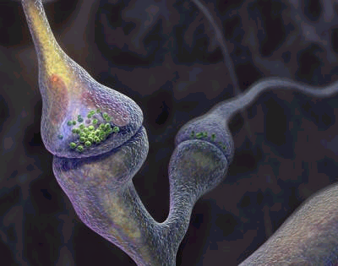
NEUROTRANSMITTER DISORDERS
METABOLISM AND/OR TRANSPORT OF
BIOGENIC AMINES
GLUTAMATE
γ-AMINOBUTYRIC ACID (GABA)
GLYCINE
http://lyrobossite.free.fr/Structure_II_L'axone.htm

Slide 10
THE CLINICAL DIAGNOSIS OF INHERITED NEUROTRANSMITTERS DISORDERS IS VERY DIFFICULT
AND NEEDS SPECIALIZED DIAGNOSTIC PROCEDURES
FOR DETECTION
Analysis of neurotransmitter disorders requires
LUMBAR PUNCTURE

Slide 11
Because there is a rostrocaudal concentration gradient
of biogenic amine metabolites in cerebrospinal fluid
the standard protocol is critical
Fraction I – BIOGENIC AMINE METABOLITES / 5-MTHF (0,5 ml of CSF)
Fraction II – AMINO ACIDS (1 ml of CSF)
Fraction III – ROUTIN BIOCHEMICAL ANALYSIS (1-2 ml of CSF)
Fraction IV - GABA (1 ml of CSF)
Fraction V - PTERIN (1 ml of CSF)

Slide 12
MONOAMINES
Biogenic amines
CATECHOLAMINES: DOPAMINE + NOREPINEPHRINE
SEROTONIN

Slide 13
GTP
Neopteryn
Phenylalanine
PAH
TRYPTOPHAN (TP)
TYROSINE (T)
BH₄
TH
TPH
BH₂
3-OMD
L-Dopa
5-OH-TRYPTOPHAN
AADC
DBH
B₆
Norepinephrine
DOPAMINE
SEROTONINE
MAO
MAO
HVA
5-HIAA

Slide 14
INHERITED DISORDERS
AFFECTING MONOAMINES METABOLISM
or
TETRAHYDROBIOPTERIN DEFICIENCY
and
INHERITED DISORDERS AFFECTING MECHANISMS CONTROLLING NEUROTRANSMISSION
cause syndromes of
MONOAMINE NEUROTRANSMITTER DEFICIENCY
with
ABNORMAL PATTERN OF MONOAMINE METABOLITES
IN CEREBROSPINAL FLUID

Slide 15
Reference values
 | 0- 6 m | 6 – 12m | 1 – 4 yrs | > 4 yrs
HVA [nmol/L] | 300 - 1000 | 300 - 1000 | 200 - 800 | 100 - 600
5-HIAA [NMOL/L] | 300 - 1000 | 200 - 800 | 100 - 600 | < 50
3-OMD [NMOL/l] | 100 - 300 | < 100 | <50 | <50

Slide 16
SYNTHESIS OF THE NEUROTRANSMITTERS
CAN BE SEVERELY COMPROMISED WHEN THERE ARE DEFECTS AFFECTING THE ENZYMES INVOLVED
BH₄
GTP
Neopteryn
TYROSINE (T)
TRYPTOPHAN (TP)
BH₄
TH
TPH
BH₂
L-Dopa
5-OH-TRYPTOPHAN

Slide 17
TETRAHYDROBIOPTERIN (BH₄)
IS THE COFACTOR FOR
phenylalanine hydroxylase (EC 1.14.16.1),
tyrosine hydroxylase (EC 1.14.16.2),
tryptophan hydroxylase (EC 1.14.16.4),
nitric oxide synthase
glyceryl-ether monooxygenase
phenylalanine
tyrosine
tyrosine
L-Dopa
tryptophan
5-hydroxytryptophan
citruline + NO.
arginine
1-O-alkyl-glycerol alkyl-adehyde + glycerol
QUINONOID DIHIDROBIOPTERIN (Q-BH₂)

Slide 18
TETRAHYDROBIOPTERIN IS ALSO COFACTOR FOR THE PHENYLALANINE HYDROXYLASE IN THE LIVER
DEFECTS OF TETRAHYDROBIOPTERIN METABOLISM
ARE IDENTIFIED
BECAUSE OF THE PRESENCE OF HYPERPHENYLALANINEMIA
FOLLOWING NEWBORN SCREENING
THESE DEFECTS MAY PRESENT PHENOTYPICALLY
WITH OR WITHOUT
HYPERPHENYLALANINEMIA

Slide 19
CLINICAL SYMPTOMS arGTPCH, PTPS, and DHPR deficiencies
Neonatal period (hyperphenylalaninemia)
  poor sucking,
  decreased spontaneous movements,
  “floppy baby”

Slide 20
arGTPCH, PTPS, and DHPR deficiencies
  Infancy and childhood
  disturbance of tone and posture
  abnormal movements
  hypersalivation and swallowing difficulties
  mental retardation
  convulsions (grand mal or myoclonic attacks),
  drowsiness,
  irritability
  recurrent hyperthermia without infections
  diurnal fluctuation

Slide 21
adGTPCH, SR
without hyperphenylalaninemia
dystonia (lower limbs, trunk, arms, neck)
parkinsonism (associated with tremor, rigidity, bradykinesia)
oculogyric crises (only SR)
psychomotor retardation (only SR)

Slide 22
MRI of the brain – normal
mild cerebral atrophy
EEG – normal
epileptiform potentials

Slide 23
IN SOME NEUROLOGICAL DISORDERS SECONDARY ABNORMALITIES OF MONOAMINES METABOLITES PATTERN ARE OBSERVED (HVA and 5-HIAA)
the group of patients with low biogenic amine
metabolites values in CSF
Lesch–Nyhan disease
Alexander disease
mitochondrial encephalopathies
pontocerebellar hypoplasia
other encephalopathies
Patients with basal ganglia involvement did not manifest lower values of neurotransmitters
García-Cazorla A. and all.; Developmental Medicine & Child Neurology 2007, 49: 740–744

Slide 24
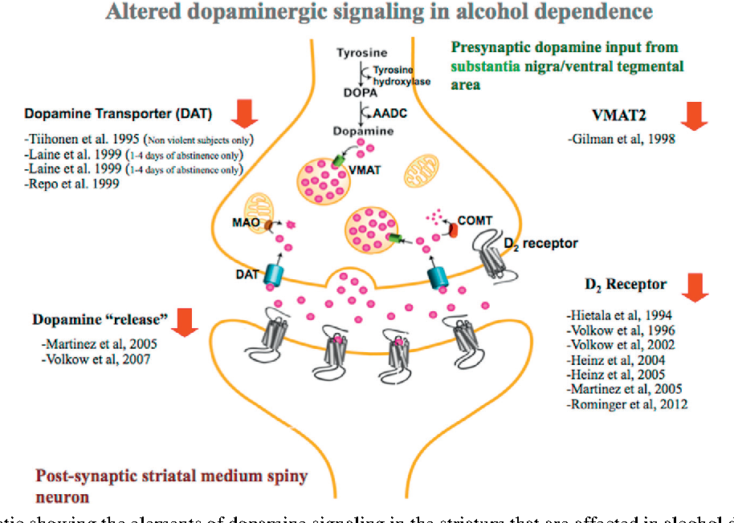
TH is responsible for the synthesis of l-dopa, a precursor of catecholamines, which can be methylated to 3-OMD and its final product - vanillyllactic acid (VLA) or decarboxylated to dopamine;
Dopamine is stored in presynaptic vesicles and then released into the synaptic cleft;
The complex process is regulated by transporters that play a key role in dopaminergic neurotransmission
The biochemical diagnosis of THD is based only on the analysis of AB metabolites in CSF and genetic tests

Slide 25
Cerebral folate deficiency
The presence of folate deficiency in the central nervous system in the presence of normal peripheral folate constitutes the syndrome of cerebral folate deficiency (CFD).
CFD can be secondary to:
drug-induced folate deficiency,
DHPR deficiency,
3-phosphoglycerate dehydrogenase deficiency,
AADC deficiency.
Folate is an essential cofactor in DNA synthesis and methylation reactions and is a critical determinant of embryonic CNS development. In its various forms, folic acid participates in the synthesis of:
purines and pyrimidines,
the metabolism of serine, histidine, methionine, homocysteine and glycine.

Slide 26
CEREBRAL FOLATE DEFICIENCY (CFD)
IS DEFINED
AS ANY NEUROLOGICAL SYNDROME
ASSOCIATED WITH
A LOW CEREBROSPINAL FLUID (CSF) CONCENTRATION
OF 5-METHYLTETRAHYDROFOLATE (5MTHF)
IN THE PRESENCE OF NORMAL PERIPHERAL FOLATE STATUS
Reference values for 5-MTHF in CSF
 | 1 – 4 yrs | > 4 yrs
5-MTHF [nmol/L] | 72 - 227 | 40 - 180
Hyland K. et all 2010

Slide 27
CEREBRAL FOLATE DEFICIENCY
deceleration of head growth from the age of 4 to 6 mo
irritability, and sleep disturbances
delayed acquisition of neurodevelopmental milestones
poor postural control
cerebellar ataxia
dyskinesias
paraparesis with pyramidal deficits
autistic features
epilepsia (myoclonic-astatic seizures, absences and generalized tonic-clonic seizures)
Hyland K. et all 2010

Slide 28
GLYCINE ENCEPHALOPATHY
Glycine, the simplest amino acid with a single amino and carboxyl group, may accumulate to pathological levels in a disorder of the glycine cleavage system, leading to nonketotic hyperglycinemia (NKT), or glycine encephalopathy.
Serine + Tetrahydrofolate Glycine + metyltetrahydrofolate
Defects of the glycine cleavage system are detected by a ratio
of CSF to plasma glycine: N:> 0.08.
Serine
hydroxymethyltransferase
PLP

Slide 29
Glycine
Structural amino acid
Metabolic intermediate
Conjugates for detoxification
Neurotransmitter (inhibitory in spinal cord)
Adjuvant to NMDA receptor

Slide 30
NONKETOTIC HYPERGLYCINEMIA
NEONATAL SEVERE
  lethargy progressing to coma
  hypotonia
  seizures
  hypoventilation, and apnea
  EEG - burst-suppression pattern
  severe mental retardation
  severe myoclonic and generalized seizure disorder
  spastic quadriplegia

Slide 31
NONKETOTIC HYPERGLYCINEMIA
VARIANT LATE-ONSET
  late onset in infancy or childhood
  seizures
  moderate mental retardation
  ataxia
  hyperactivity and/or chorea

Slide 32
CLINICAL SYMPTOMS
developmental delay
prominent language deficits
hypotonia
ataxia
seizures
MRI - increased signal in the globus pallidus

Slide 33
Non-ketotic hyperglycinaemia
Treatment
Sodium benzoate lowers plasma glycine
Dextromethorphan / ketamine
Anticonvulsants
Notes:
33

Slide 34
Confirmatory tests
Enzyme assay
  Liver
  Transformed lymphoblasts
Mutation analysis
Prenatal diagnosis
Enzyme assay on CVB (uncultured)
  Sometimes equivocal
Mutation analysis

Slide 35
Secondary hyperglycinaemia
Sodium valproate
Organic acidaemias
Pyridoxine / Pyridoxal-P dependency

Slide 36
Pyridoxine responsive epilepsy
Onset usually neonatal, maybe up to 2 yrs
Multiple seizure types
Usually resistant to anticonvulsants
Seizures
Often fetal distress, acidosis, hypotonia
Usually dramatic response to IV pyridoxine
  Apnoea / hypotension for 24 hours
Notes:
36

Slide 37
Pyridoxine responsive epilepsy
Treatment
Pyridoxine 5-10 mg/kg/day
(peripheral neuropathy with high doses)

Slide 38
Glutamate
decarboxylase
GABA
transaminase
Aromatic aminoacid
decarboxylase
Glycine
cleavage enzyme
Lysine
Pipecolic acid
α-aminoadipic
semialdehyde
piperideine
6-carboxylate
Pyridoxal
phosphate
αAASA
dehydrogenase
Inactive
product

Slide 39
Metabolism of Glutamate and GABA
phosphate activated
glutaminase
Glutamate
decarboxylase
GABA –
transaminase
Glutamine
Glutamate
GABA
PNP
PNP
SSAD
dehydrogenase
Succinate semialdehyde
(SSAD)
Succinate
NADH
The functional status of the central nervous system (CNS) is based on
a highly regulated balance between excitatory and inhibitory circuits.
Based on the fact that these neurotransmission systems to a large extent are using the two amino acids Glutamate and GABA as transmitters in excitation and inhibition, respectively.

Slide 40
GABA
GABA transaminase deficiency
2 families reported
Seizures
Severe developmental delay
Diagnosis by CSF GABA
GABA
transaminase
Succinate
semialdehyde
SSA
dehydrogenase
Succinate

Slide 41
GABA
GABA transaminase
Succinate
semialdehyde
4-hydroxybutyrate
SSA dehydrogenase
Succinate

Slide 42
SSADH deficiency
Developmental impairment esp. speech
Behaviour problems
Ataxia
Seizures
Diagnosis: 4-hydroxybutyrate on urine OA
Treatment: supportive
(vigabatrin ineffective)

Slide 43
Neurotransmitter disorders: Summary
Present with seizures, developmental impairment, extrapyramidal or eye movement disorders, startle, hypotonia, sleep or behaviour problems etc
Mostly in neonates or infants but sometimes later
Awareness is essential
Specific treatment is needed for some disorders
Consider therapeutic trial (B6, Dopa)
Some disorders detected by OAs, AAs
Specialist analysis of CSF is required for others
Protocol for CSF collection is important

